Slide 1
COVID-19: ANALYSIS AND VISUALIZATION
Bunmi Olakanmi
Chris Inalsingh
Moné-Renata Holder Seale
Nihal Joshua

Slide 2
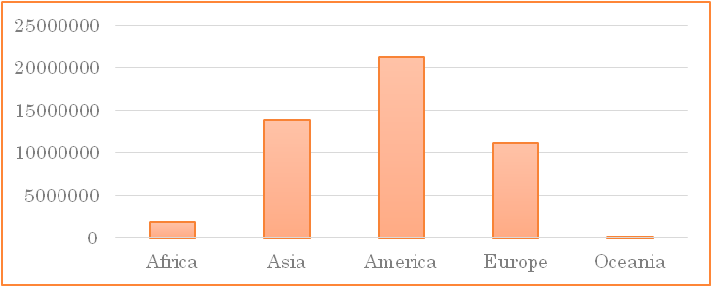
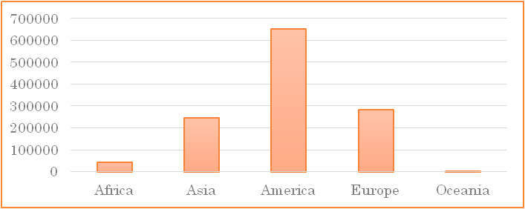
MOTIVATION & SUMMARY
COVID-19, a disease caused by SARS-CoV-2 corona virus.
First recognized in December 2019.
Declared a pandemic by WHO in March 2020
Cases and deaths reported till Nov 5, 2020:
COVID - 19 Cases
Deaths due to COVID - 19

Slide 3
MOTIVATION & SUMMARY
Interventions:
  Limit to the size of indoor and outdoor gatherings
  Physical distancing of 2ft from the next person
  Use of mask
  Increased testing
Impacts
  Employment
  GDP
  Lifestyle change
  Increased mortality
Notes:
https://www.ecdc.europa.eu/en/geographical-distribution-2019-ncov-cases

Slide 4
MOTIVATION & SUMMARY
With the rise in the number of cases and mortality in some regions, we want to:
  Know what the trend is like in Canada.
  Know the economic impacts of COVID-19
    Unemployment and GDP growth.
  Know the impacts of COVID-19 on excess deaths
  Know the relationship between COVID-19 deaths and deaths due to Influenza / Pneumonia.
Notes:
https://www.ecdc.europa.eu/en/geographical-distribution-2019-ncov-cases

Slide 5
QUESTIONS
What is the wave of COVID-19 in Canada?
  From February 2020 to September 2020.
What is the impact of COVID-19 on unemployment in Canada?
What is the impact of COVID-19 infections on excess deaths?
Is their a trend between COVID-19 related deaths, and deaths due to seasonal flu (pneumonia and influenza)?
What are the key patterns observed between interventions and economic impact?
  COVID-19 vs. GDP growth for different countries
Notes:
Americas (North America, South America, Central America, Caribbean),
Asia Pacific (Central & South Asia, Northeastern Asia, Southeastern Asia, Australia and Oceania),
Europe (Northern Europe, Southern Europe, Eastern Europe, Western Europe),
and the Middle East/Africa (Middle East, Northern Africa, Southern Africa)

Slide 6
METHODS: DATA
Our data comprise COVID-19 data on unemployment, GDP growth, mortality count from sources, such as:
  Centers for disease control and prevention – CDC.gov¹
  Kaggle²
  The centre for humanitarian data³
  Ourworldindata⁴
  COVID19 Canada⁵
1. https://data.cdc.gov/NCHS/Provisional-Death-Counts-for-Influenza-Pneumonia-a/ynw2-4viq/data
2. https://www.kaggle.com/sudalairajkumar/novel-corona-virus-2019-dataset
3. https://data.humdata.org/dataset/financial-times-excess-mortality-during-covid-19-pandemic-data
4. https://ourworldindata.org/covid-health-economy
5. https://resources-covid19canada.hub.arcgis.com/datasets/0ecd269194284477b883465e99354ba3_0/geoservice
Notes:
To answer these questions, we analysed data from different source, as mentioned above:

Slide 7
METHODS: DATA CLEANUP & EXPLORATION
Data download from resource websites
Data import to Jupiter notebook
Data cleaning: using python libraries to exclude irrelevant and incomplete data
Data analysis and visualization to answer our questions
  Summary statistics
  Regression analysis
  Scatter plots
  Bar chats

Slide 8
METHODS: DATA ANALYSIS
Q1: Time series of confirmed COVID-19 cases in Canada.
Q2: Regression between confirmed cases per month and unemployment rate in Canada (Mar – Sept 2020).
Q3: Regression on excess mortality rate and COVID-19 infected
Q4: Regression between deaths due to COVID-19 and seasonal flu (Pneumonia/Influenza)
Q5: Bar graph comparing GDP growth for some countries.
  (GDP Growth-Q2, 2020)
Notes:
What are the waves of COVID-19 across the regions of the world?
Africa, Asia, America, Europe, Oceania.
What are the successes recorded with the COVID-19 Interventions in these regions?
What is the Economic Impact of COVID-19?
Unemployment, stock market, inflation
COVID-19 and impact on other mortality rates due to lifestyle
e.g. driving, drinking, drugs
Differences between COVID-19 Infections and normal Flu.
Key patterns observed between interventions and flattening the curve.
Key patterns observed between interventions and long-term economic impact.

Slide 9
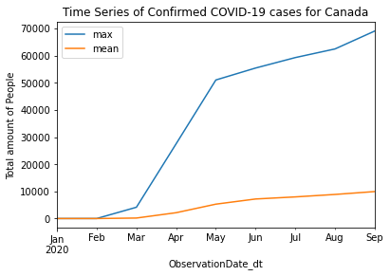
RESULTS & DISCUSSION (Q1)
Initial slight increase in cases (Feb – Mar), which became steeped in spring (Mar – May).
Then, the curve was getting flattened in the summer months (May – Aug)
An increase in cases is observed from September.
Notes:
Average increase in cases was higher in the spring than the summer months
The curve seemed flattened during the summer months
An increase is observed from September

Slide 10
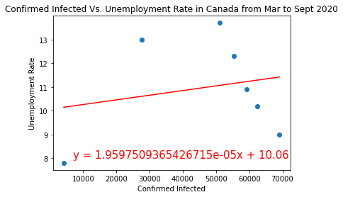
RESULTS & DISCUSSION (Q2)
R = 0.21
There is a weak positive relationship between confirmed COVID-19 cases and unemployment rate in Canada.
  As the number of cases increases, we expect just a very small increase in the unemployment rate.
  Reasons: CERB, wage subsidies
Notes:
This is expected because the Canadian government did a lot to reduce the impact of COVID on employment – CERB, wage subsidy (75%) to employers, loans to entrepreneurs (40k)

Slide 11
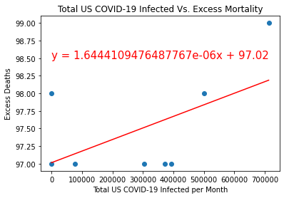
RESULTS & DISCUSSION (Q3)
r = 0.55, p = .15
There is a moderate positive relationship between COVID-19 infected and deaths due to other issues.
  We expect an increase in excess death with an increase in COVID-19 infections.
  Reason(s): rise in mental health conditions, delayed in medical interventions for people with comorbidities, inadequate medical facilities.

Slide 12
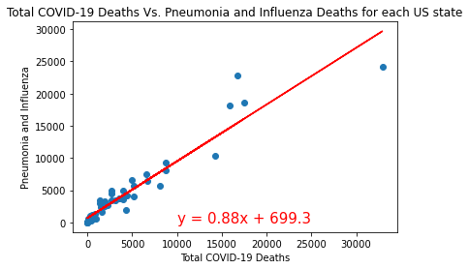
RESULTS & DISCUSSION (Q4)
r= 0.95, p = 1.84e-27
There is a strong positive relationship between the total COVID-19 deaths, and deaths due to pneumonia and influenza in the USA.
  COVID-19 related death is very similar to death due to pneumonia and seasonal flu in the USA.
  Reasons(s): mode of transmission and symptoms.
  Further work is required to uncover other contributory factors

Slide 13
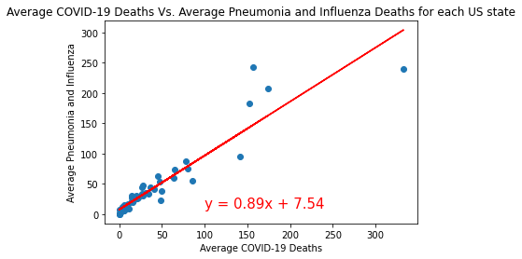
RESULTS & DISCUSSION(Q4)
r= 0.93, p = 1.71e-23
There is a strong positive relationship between the average COVID-19 deaths, and average deaths due to pneumonia and influenza in the USA.
  Average COVID-19 related death is similar to average death due to pneumonia and seasonal flu in the USA.

Slide 14
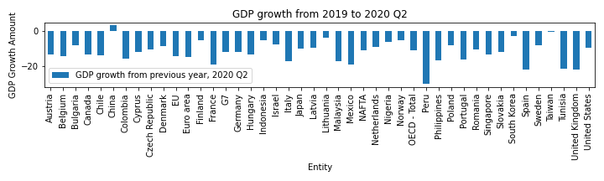
RESULTS & DISCUSSION (Q5)
With respect to GDP growth, most countries, except China, are negatively impacted by in Q2 of 2020.
Most negative impacts felt in some of the following regions
  South America: Peru, Mexico, Colombia
  Europe: United Kingdom, Spain, France, Italy
  Africa: Tunisia

Slide 15
SUMMARY
There is a surge in COVID-19 cases in Canada from September.
COVID-19 has a small effect on unemployment in Canada, from March-September 2020.
  An increase in excess death is expected with an increase in COVID-19 infections.
There is a strong positive relationship between COVID-19 related deaths, and deaths due to pneumonia and Influenza in the USA.
  We should expect a further increase in death due to pneumonia and influenza, when there is an increase in COVID-19 related deaths.
There is a negative trend in the GDP growth of most countries, except China, in the Q2 of 2020.

Slide 16
LIMITATIONS
Lack of economic data to project the effects of COVID-19.
  Most countries stopped the long term economic projection due to COVID-19 effect.
Bias in data due to differences in testing rates and interventions between countries.
Inability to validate statistics coming from different countries.

Slide 17
QUESTIONS

